Slide 1
Machine Learning Clustering
All Cluster algorithms definitions
and explanations with its Python codes.

Slide 2
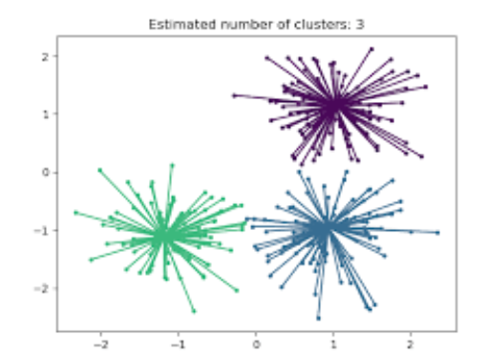
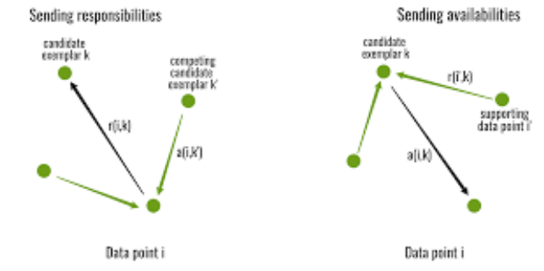
Affinity Propagation Clustering
Affinity Propagation is a clustering algorithm that uses message passing between data points to find clusters.
It's used in data mining and statistics.

Slide 3
How it works
AP takes similarity measurements between pairs of data points as input
It considers all data points as potential exemplars
AP sends messages between pairs of data points to determine which data points are best suited to be exemplars
AP updates the messages iteratively until it converges
AP chooses the final exemplars and forms clusters based on them
Features
AP doesn't require the number of clusters to be specified before running the algorithm
AP finds exemplars that represent clusters
AP is simple, generally applicable, and performs well

Slide 4

Applications:
AP has been used in fingerprint datasets for indoor localization
AP has been used in petrochemical industries for production capacity analysis and energy optimization
AP has been used for community detection in complex networks
Python code:

Slide 5
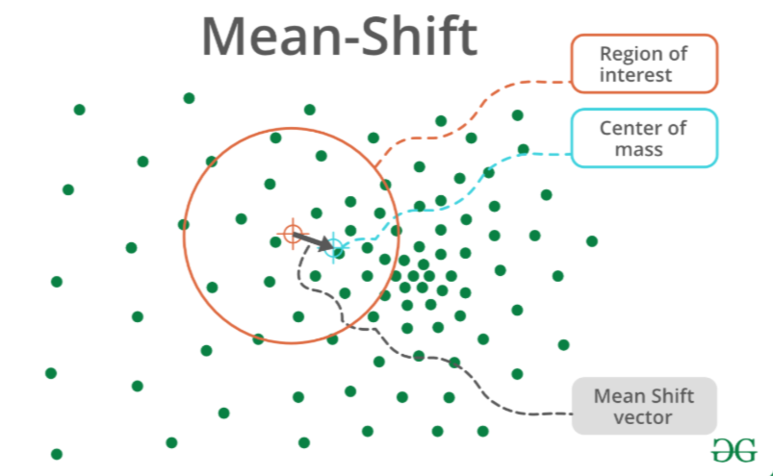
Mean Shifting Clustering

Slide 6
How it works
Mean shift clustering is an unsupervised machine learning algorithm that identifies clusters in data by iteratively moving data points towards regions of higher density.
essentially "shifting" them towards the mean of nearby points, without requiring the user to specify the number of clusters beforehand.
it's considered a density-based clustering method that finds "blobs" in data by identifying areas of high density.
A major advantage is that it automatically determines the number of clusters present in the data.
Data points are repeatedly shifted towards the higher density region until convergence, where no further significant movement occurs.
The algorithm uses a kernel function (like a Gaussian kernel) to define a local neighbourhood around each data point, and the "shift" is calculated based on the mean of points within that neighbourhood.

Slide 7

Applications of mean shift clustering:
Image segmentation
Object tracking in video sequences
Customer segmentation based on buying behaviour
Analyzing geospatial data to identify clusters of activity
Medical image analysis to detect abnormalities.
Python Code:

Slide 8
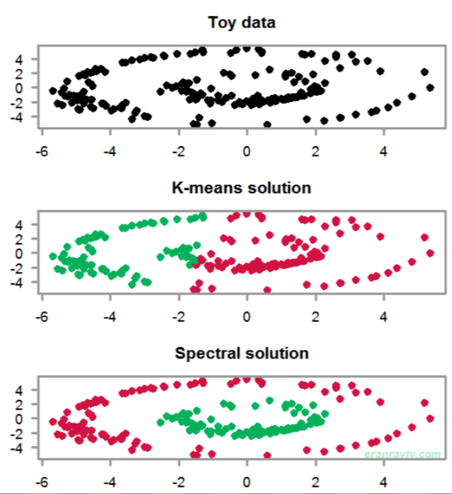
Spectral Clustering

Slide 9
Spectral clustering is a graph-based technique that uses spectral decomposition to group similar data points into clusters. The data points are treated as nodes of a graph.
How it works
The nodes are mapped to a low-dimensional space that can easily be segregated to form clusters.
No assumption is made about the shape/form of clusters.
The goal of spectral clustering is to cluster data that is connected but not necessarily compact.
When it's used
Spectral clustering is well-suited for complex or non-linear data
It's a leading unsupervised classification algorithm
It's used in various applications, including clustering homologous proteins

Slide 10

Related terms
Spectral graph theory: The theory that underpins spectral clustering
Linear algebra: The math that underpins spectral clustering
Spectral co-clustering: An algorithm that clusters rows and columns of an array
Python code:

Slide 11
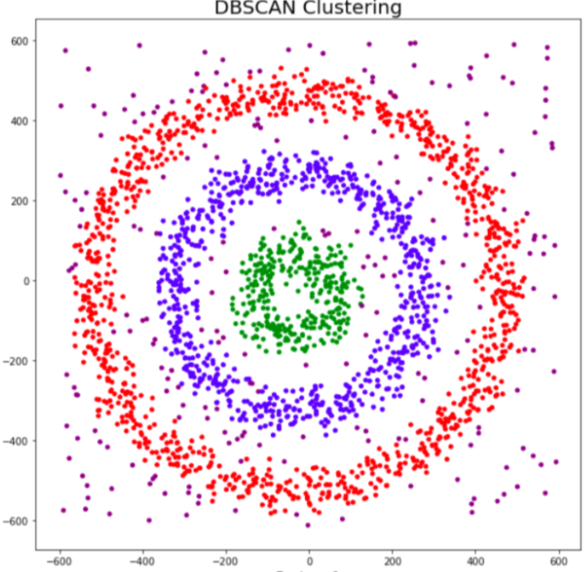
DBSCAN Clustering
DBSCAN - Density-Based Spatial Clustering of
Applications with Noise
It is a machine learning algorithm that groups data
points into clusters based on their density.
It's a popular algorithm used in many fields
including image segmentation, anomaly
detection, and geospatial data analysis.

Slide 12
How it works:
DBSCAN starts by randomly selecting a data point
It then finds other data points within a certain radius of the selected point
If there are enough points within the radius, they are considered part of the same cluster
The algorithm then repeats the process for each neighboring point to expand the cluster
DBSCAN's advantages:
DBSCAN can identify clusters of arbitrary shapes
It doesn't require the number of clusters to be specified in advance
It can identify outliers as noise points
It's effective at identifying and removing noise in a data set.

Slide 13

DBSCAN has two parameters:
epsilon: The maximum distance allowed between two points within the same cluster
minimum samples: The minimum number of data points required to form a distinct cluster
Python code:

Slide 14
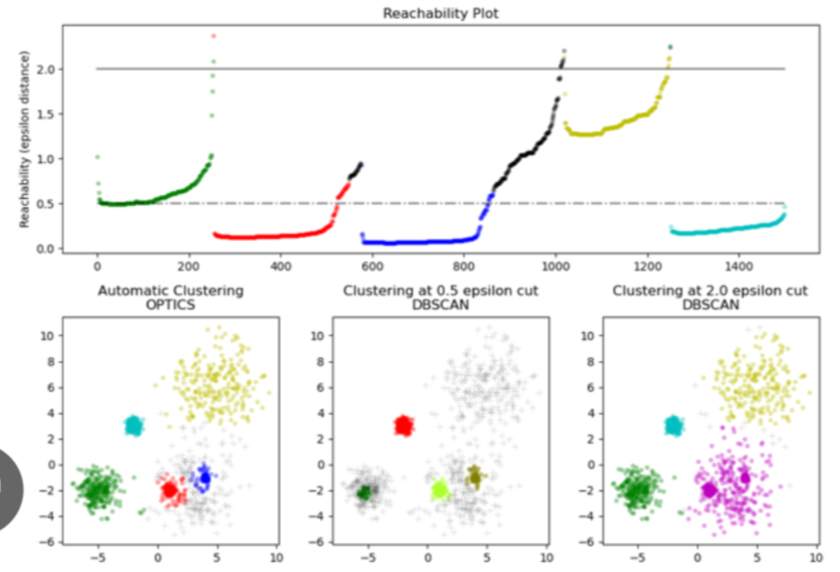
OPTICS Clustering

Slide 15
OPTICS - Ordering Points To Identify the Clustering Structure.
It is a clustering algorithm that groups data points into clusters based on their density.
The main idea is to extract clustering structure of a dataset by identifying density connected points.
This algorithm builds a density based representation of the data by creating an ordered list of points called reachability plot.
Each point in the list is associated with reachability distance, where it can reach that point from another points in the dataset.
Points with similar reachability distance are likely to be in the same cluster.
Maintains cluster members in a priority queue instead of a set
Similar to DBSCAN, another density-based clustering algorithm

Slide 16

Python code:

Slide 17
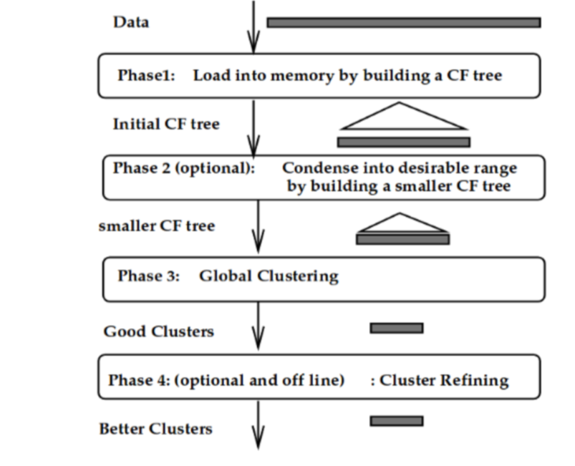
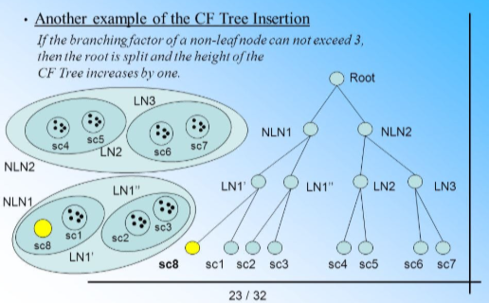
BIRCH Clustering

Slide 18
BIRCH (Balanced Iterative Reducing and Clustering using Hierarchies)
It is a machine learning algorithm that groups large amounts of data into clusters.
It's a hierarchical clustering technique that uses Clustering Features (CFs) to summarize clusters.
BIRCH builds a CF tree in memory
It uses a threshold to control cluster formation and a branching factor to limit the number of sub-clusters
It uses agglomerative hierarchical clustering to cluster small-diameter dense sub-clusters
This algorithm clusters large dataset by first generating small summary that retains much information as possible.
This smaller summary is then clustered instead of large dataset.

Slide 19

Benefits of BIRCH:
Scalability: BIRCH can handle large datasets efficiently
Fast clustering: The CF tree structure allows for fast traversal and clustering
Linear scaling: BIRCH can find a good clustering with a single scan and improve the quality with a few additional scans
Python code:

